Slide 1
Angular 2 observables

Slide 2
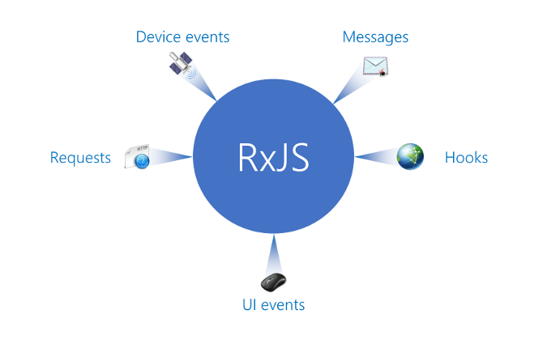
rxjs

Slide 3
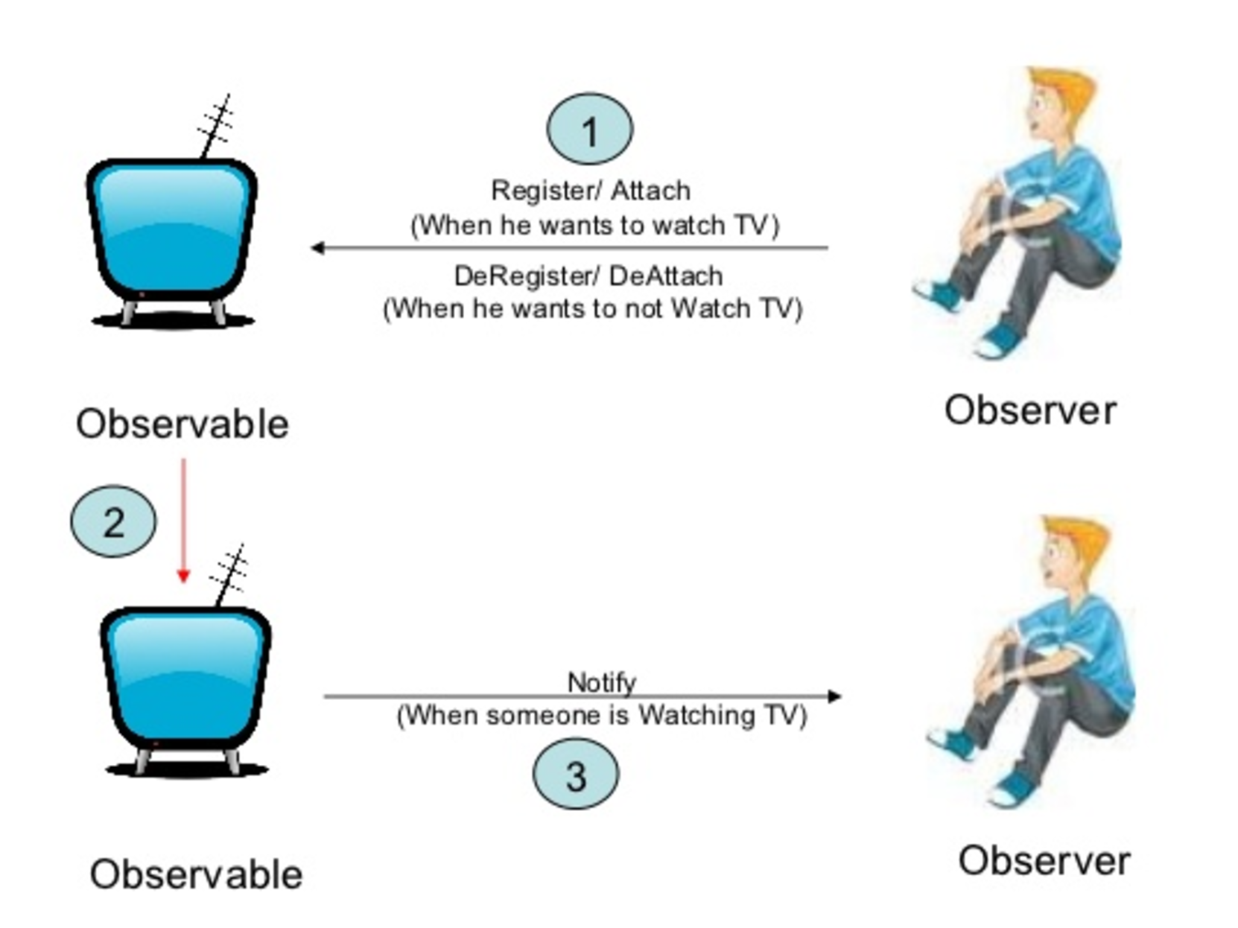
Observable pattern

Slide 4
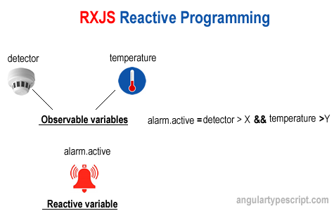

Slide 5
Create and subscribe observable
var observable = Observable.create(function (observer) { observer.next(42); observer.next(42); observer.complete(); });
var subscription = observable.subscribe( function (value) { console.log('Next: %s.', value); }, function (ev) { console.log('Error: %s!', ev); }, function () { console.log('Completed!'); } ); subscription.dispose();
Notes:
As a best practice we should terminate the subscription by using the dispose method. This will perform any required cleanup steps. Otherwise, it might be possible to prevent garbage collection from cleaning up unused resources.
Without subscribe the observable contained in the variable observable is just a cold observable. Nevertheless, it is also possible to convert it to a hot sequence (i.e., we perform a pseudo subscription) using the publish method.

Slide 6
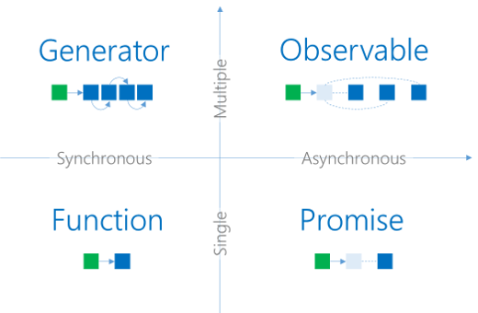
Data producers

Slide 7
How to get observable?
Observable creation helpers in RxJS
• Observable.of(value, value2, value3, …)
• Observable.from(promise/iterable/observable)
• Observable.fromEvent(item, eventName)
• Angular’s HTTP and Realtime Data services
• Many community-driven RxJS modules and libraries

Slide 8
Observable error handling
myObservable.catch(error => { if (error instanceof OkayError) { return Observable.of("okay"); } else { throw error; } });

Slide 9
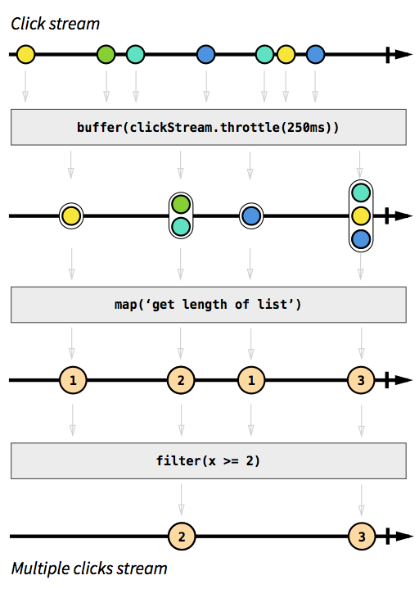
Rxjs example
TASK:
Get stream of "double click" events. consider triple clicks as double clicks.

Slide 10
Component with promises
@Component({ templateUrl: '../html/films.html' }) export class FilmsComponent { title: string = 'Films'; filmsPromiseArray: FilmModel[] = new Array(); errorMessage: string; constructor( private _http: Http) { } ngOnInit() { this.getFilmsPromise().then(items => this.filmsPromiseArray = items); } getFilmsPromise(): Promise<FilmModel[]> { return this._http.get('http://swapi.co/api/films') .toPromise() .then((response) => response.json().results); } }

Slide 11
Component with observable
export class FilmsComponent { title: string = 'Films'; films: FilmModel[]; constructor(private _http: Http) { } ngOnInit() { this.getFilmsObservable() .subscribe(data => this.films = data); } getFilmsObservable(): Observable<FilmModel[]> { return this._http.get('http://swapi.co/api/films') .map((response: Response) => response.json() as FilmModel[]) .do(data => console.log(JSON.stringify(data))) .catch(this.handleError); } private handleError(error: Response) { console.error(error); return Observable.throw(error.json().error || 'Server error'); } }

Slide 12
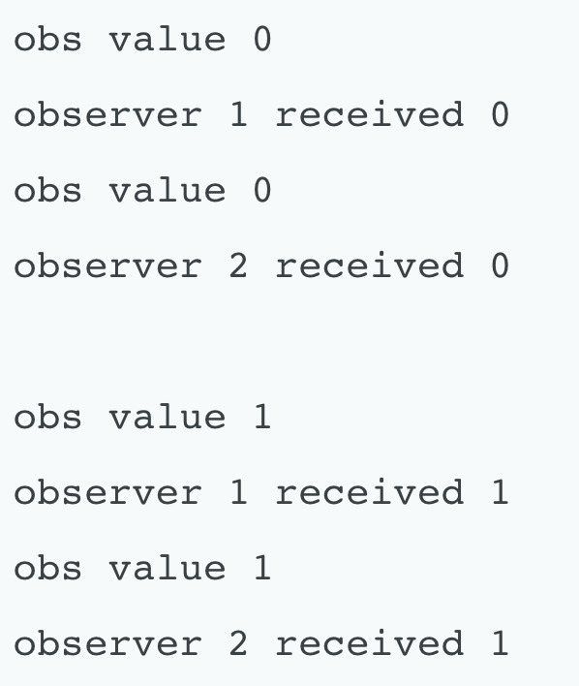
Hot and cold observables
Hot observables are pushing even when we are not subscribed to them (e.g., UI events).
Cold observables start pushing only when we subscribe. They start over if we subscribe again.
var obs = Observable.interval(500).take(5) .do(i => console.log("obs value "+ i) ); obs.subscribe(value => console.log(
"observer 1 received " + value)); obs.subscribe(value => console.log(
"observer 2 received " + value));
When we create a subscriber, we are setting up a whole new separate processing chain.
Observable is not shared: each subscriber get its own copy.

Slide 13
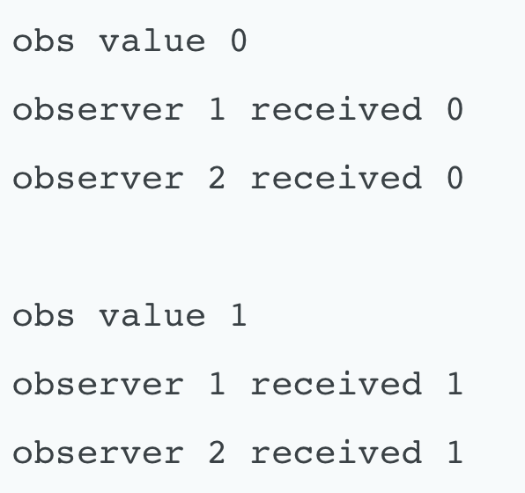
Share operator
The share operator allows to share a single subscription of a processing chain with other subscribers.
var obs = Observable.interval(500).take(5) .do(i => console.log("obs value "+ i) ) .share(); obs.subscribe(value => console.log(
"observer 1 received " + value)); obs.subscribe(value => console.log(
"observer 2 received " + value));

Slide 14
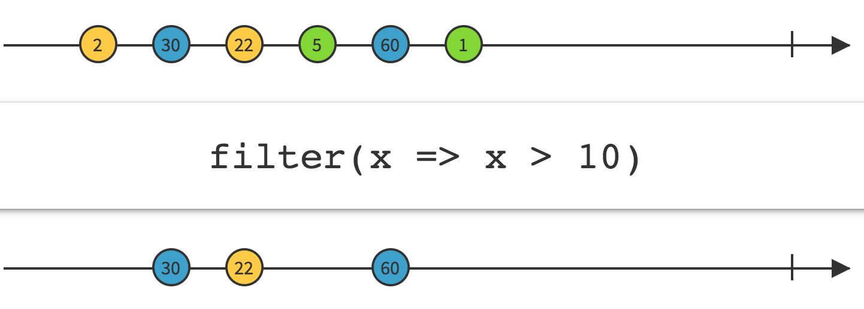
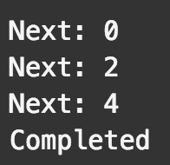
Filter operator
var source = Observable.range(0, 5) .filter(function (x, idx, obs) { return x % 2 === 0; }); var subscription = source.subscribe( function (x) { console.log('Next: %s', x); }, function (err) { console.log('Error: %s', err); }, function () { console.log('Completed'); });

Slide 15
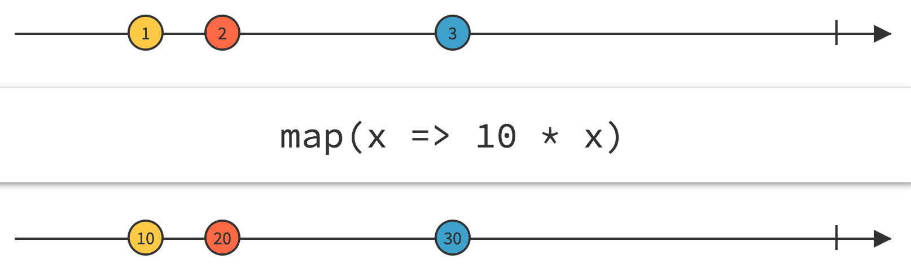
Map operator
// Using a value var md = Observable.fromEvent(document, 'mousedown')
.map(e=>{ return { x:e.x, y: e.y} });
var subscription = source.subscribe( function (a) { console.log(’Mouseclick at (${a.x},${a,y}) ‘); }, function (err) { console.log('Error: ' + err); }, function () { console.log('Completed'); });

Slide 16
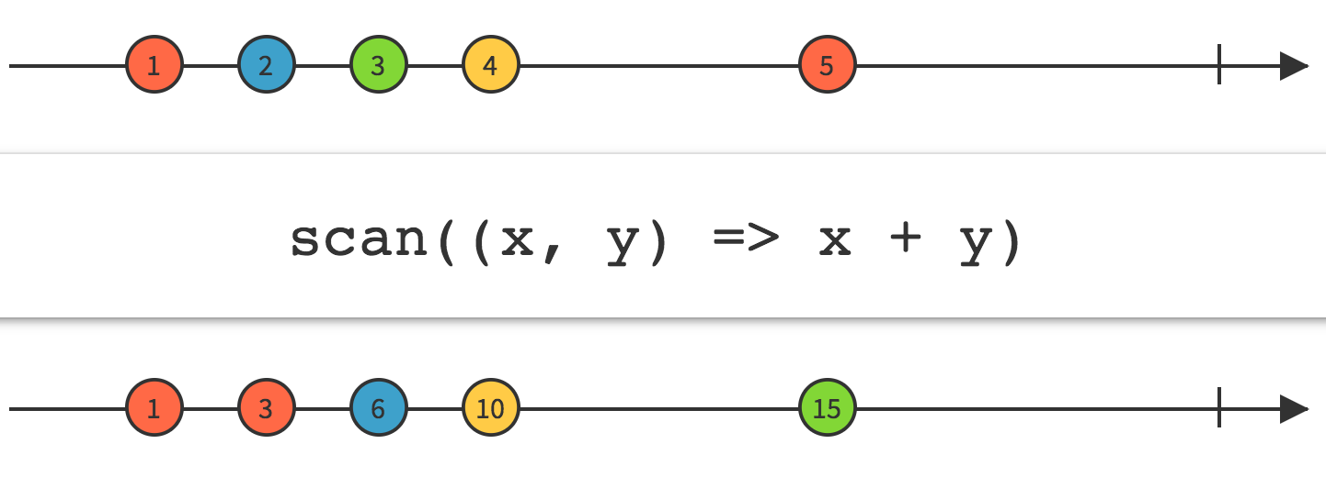
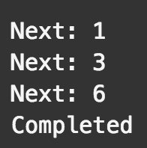
Scan operator
var source = Observable.range(1, 3) .scan( function (acc, x) { return acc + x; }); var subscription = source.subscribe( function (x) { console.log('Next: ' + x); }, function (err) { console.log('Error: ' + err); }, function () { console.log('Completed'); });

Slide 17
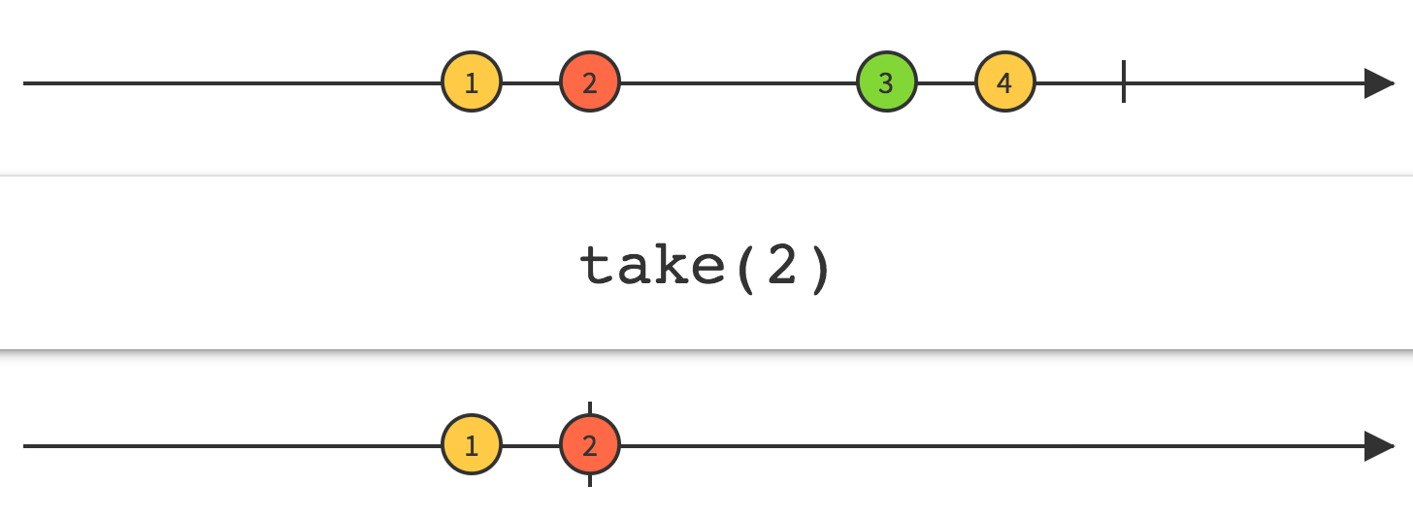
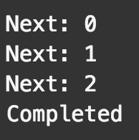
Take operator
var source = Observable.range(0, 5).take(3); var subscription = source.subscribe( function (x) { console.log('Next: ' + x); }, function (err) { console.log('Error: ' + err); }, function () { console.log('Completed'); });

Slide 18
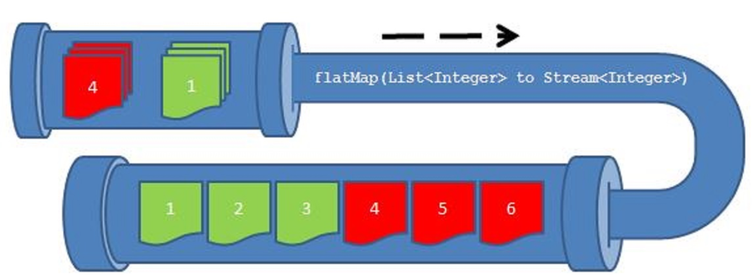
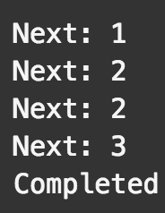
Flatmap operator
flatMap ->
var source = Observable .range(1, 2) .flatMap(function (x) { return Observable.range(x, 2); }); var subscription = source.subscribe( function (x) { console.log('Next: ' + x); }, function (err) { console.log('Error: ' + err); }, function () { console.log('Completed'); });
1 2
1 2
2 3
1
2
2 3

Slide 19
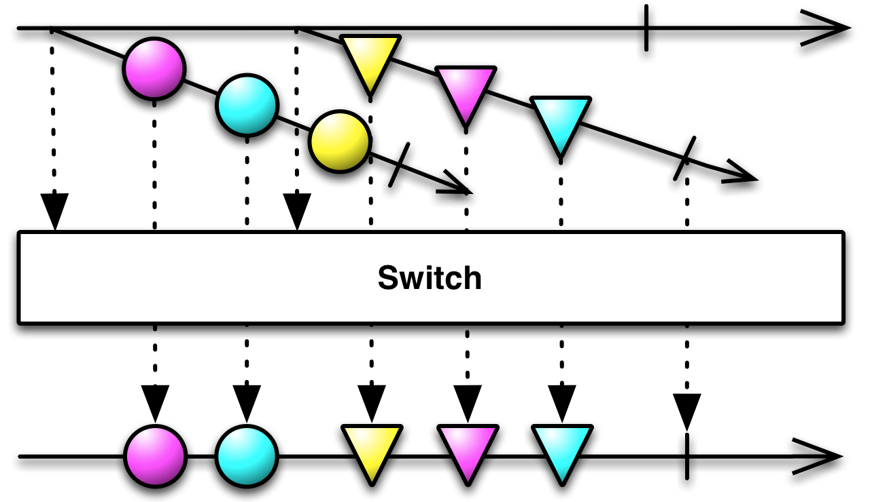
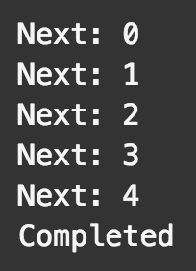
Switch operator
var source = Observable.range(0, 3) .map(function (x) { return Observable.range(x, 3); }) .switch(); var subscription = source.subscribe( function (x) { console.log('Next: ' + x); }, function (err) { console.log('Error: ' + err); }, function () { console.log('Completed'); });
0 1 2
0 1 2
1 2 3
2 3 4
switch
switch
0
1
2 3 4
timeline

Slide 20
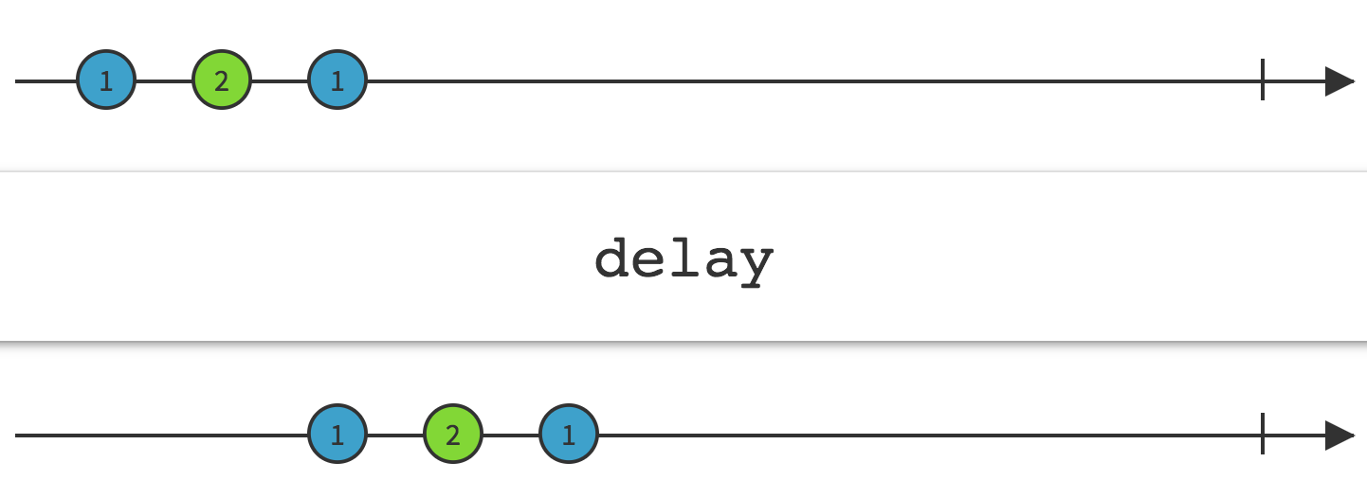
Delay operator
var source = Observable.range(0, 3) .delay(1000); var subscription = source.subscribe( function (x) { console.log('Next: ' + x.toString()); }, function (err) { console.log('Error: ' + err); }, function () { console.log('Completed'); });

Slide 21
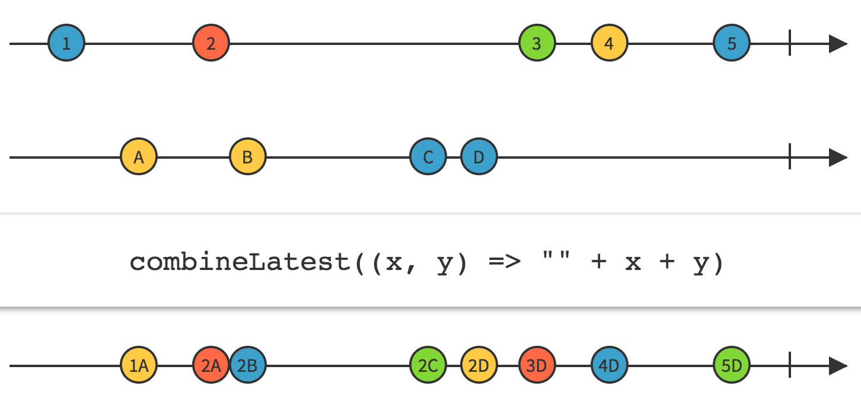
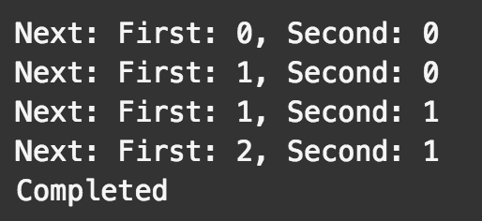
Combinelatest operator
/* Have staggering intervals */ var source1 = Observable.interval(100) .map(function (i) { return 'First: ' + i; }); var source2 = Observable.interval(150) .map(function (i) { return 'Second: ' + i; }); // Combine latest of source1 and source2 whenever either gives a value var source = source1.combineLatest(source2, function (s1, s2) { return s1 + ', ' + s2; }).take(4); var subscription = source.subscribe(x=>console.log('Next: ' + x.toString()), err=>console.log('Error: ' + err), ()=>console.log('Completed'));

Slide 22
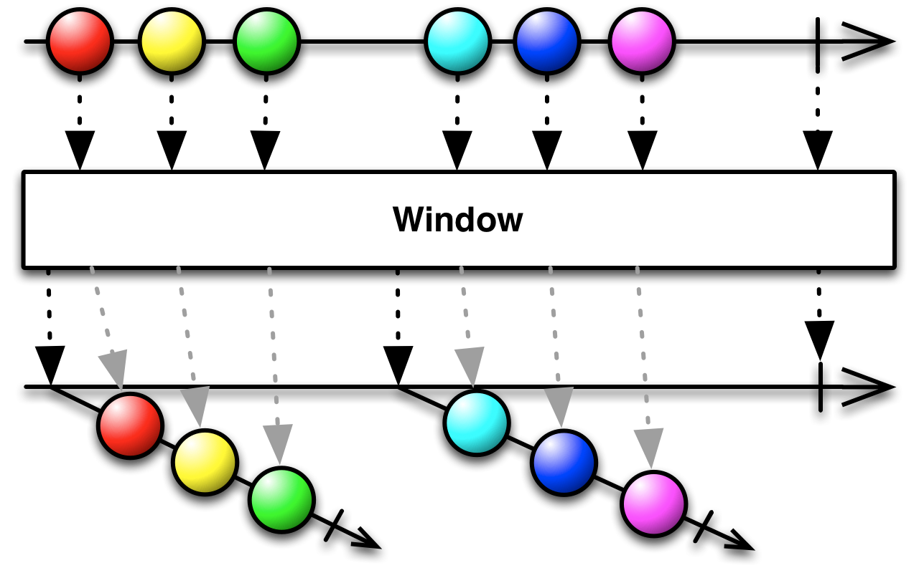
Window operator
window(windowClosingSelector)
windowWithCount(count)
windowWithTime(timeSpan)
windowWithTimeOrCount(timeSpan,count)
…

Slide 23
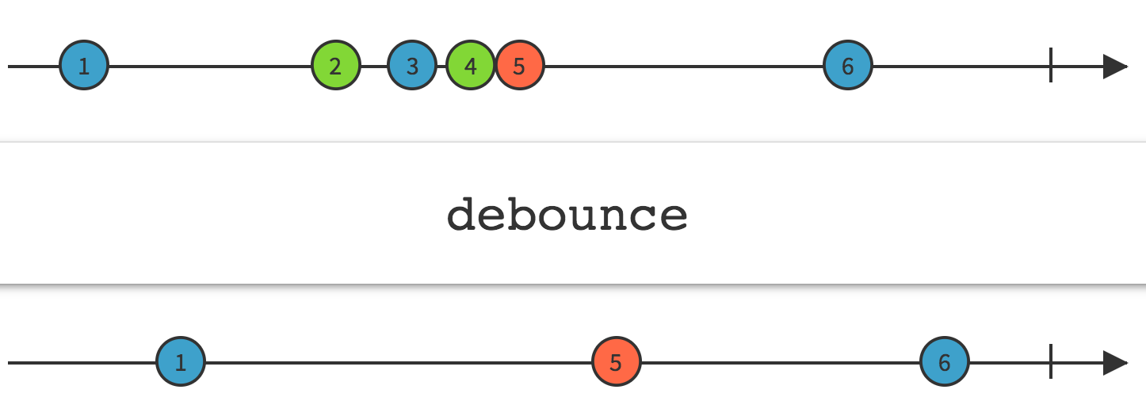
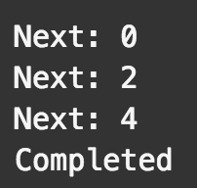
Debounce operator
The Debounce technique allow us to "group" multiple sequential calls in a single one.
Debouncing enforces that a function not be called again until a certain amount of time has passed without it being called. As in "execute this function only if 100 milliseconds have passed without it being called."
0
100 0
200
300
400
500
600 debounce
700 1
800
900
1000
1100 2
1200
1300
1400
1500
1600 debounce
…
// Delay each item by time and project value; var source = Observable.from(times) .flatMap(function (item) { return Rx.Observable .of(item.value) .delay(item.time); }) .debounce(500 /* ms */); var subscription = source.subscribe( (x)=>console.log('Next: %s', x));
var times = [ { value: 0, time: 100 }, { value: 1, time: 600 }, { value: 2, time: 400 }, { value: 3, time: 700 }, { value: 4, time: 200 } ];
500ms
500ms

Slide 24
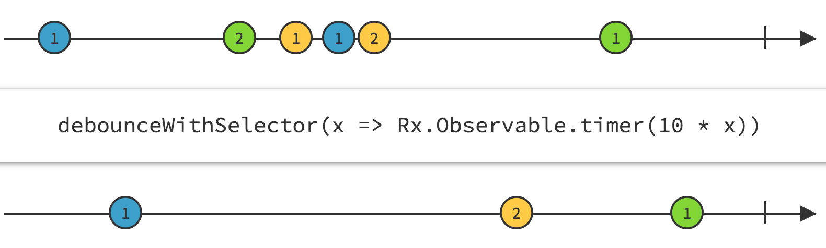
Debouncewithselector operator

Slide 25
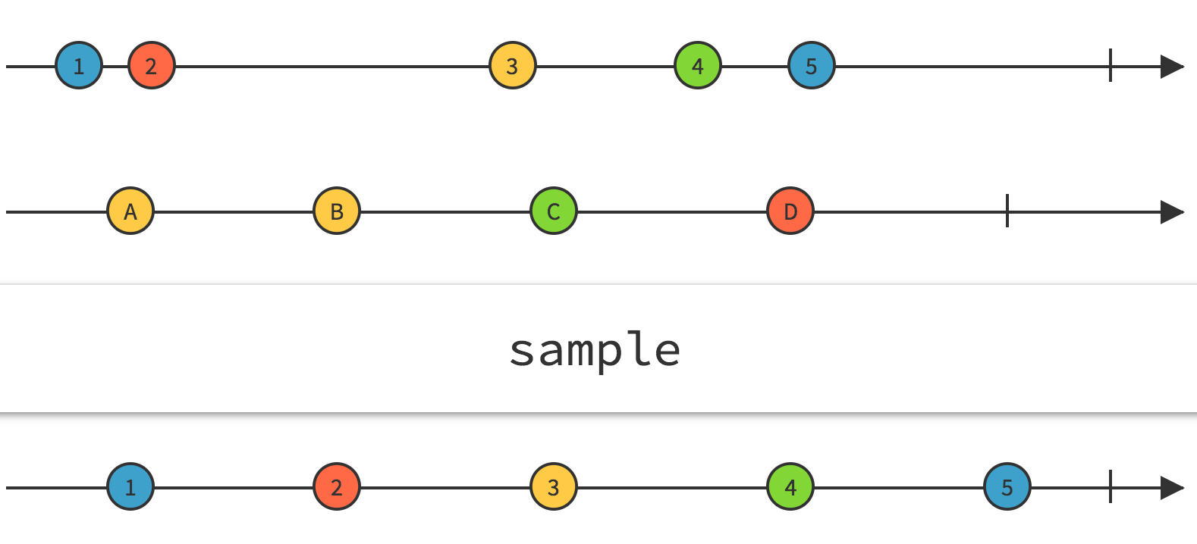
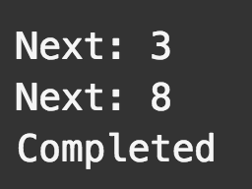
Sample operator (throttlelast)
The main difference between throttle and debounce is that throttle guarantees the execution of the function regularly, at least every X milliseconds.
Throttling enforces a maximum number of times a function can be called over time. As in "execute this function at most once every 100 milliseconds."
time value
1s 0
2s 1
3s 2
4s 3
5s sample: 3
5s 4
6s 5
7s 6
8s 7
9s 8
10s sample:8
var source = Observable.interval(1000) .sample(5000) .take(2); var subscription = source.subscribe( function (x) { console.log('Next: ' + x); }, function (err) { console.log('Error: ' + err); }, function () { console.log('Completed'); });

Slide 26
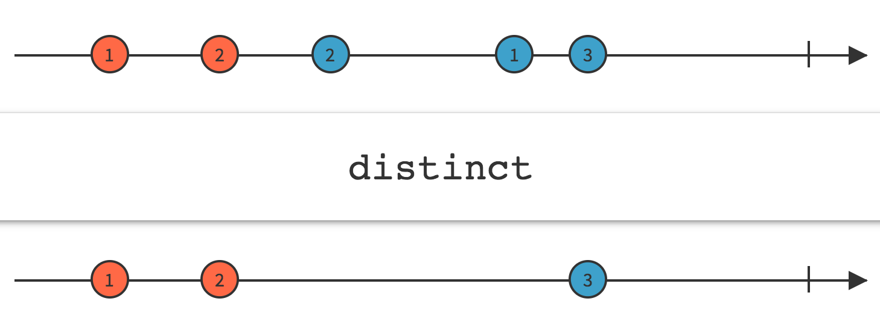
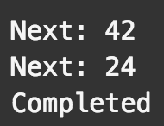
Distinct operator
/* Without key selector */ var source = Observable.fromArray([ 42, 24, 42, 24 ]) .distinct(); var subscription = source.subscribe( function (x) { console.log('Next: ' + x.toString()); }, function (err) { console.log('Error: ' + err); }, function () { console.log('Completed'); });

Slide 27
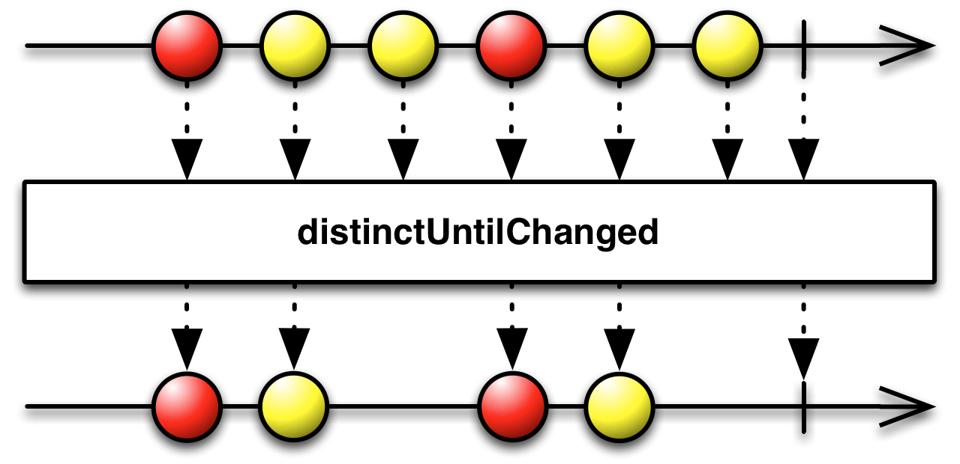
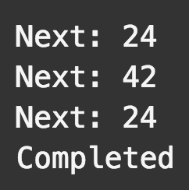
distinctUntilChanged operator
var source = Observable.fromArray([ 24, 42, 24, 24 ])
.distinctUntilChanged(); var subscription = source.subscribe( function (x) { console.log('Next: ' + x); }, function (err) { console.log('Error: ' + err); }, function () { console.log('Completed'); });

Slide 28
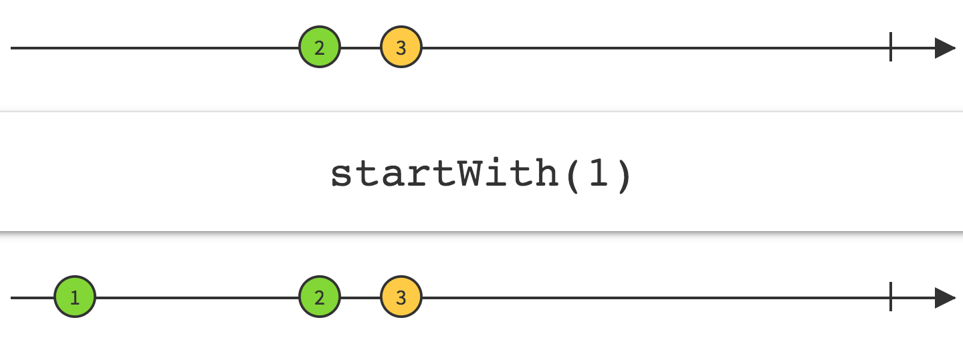
StartWith operator

Slide 29
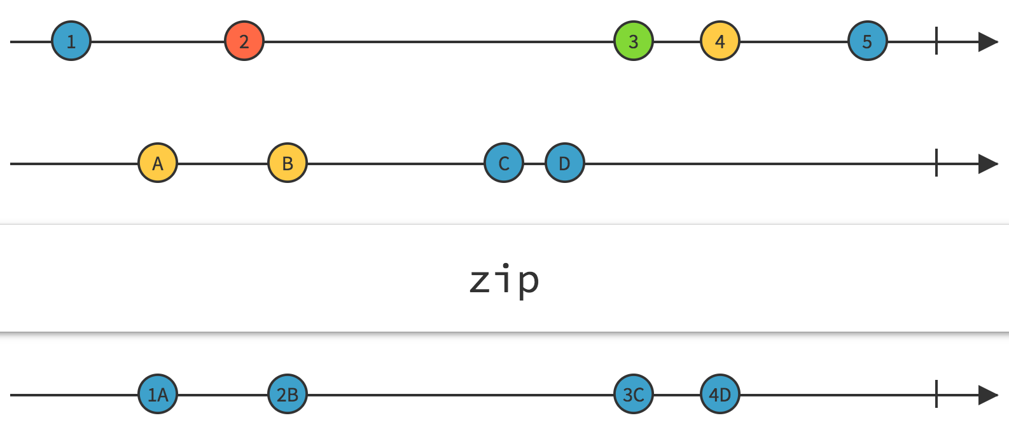
Zip operator

Slide 30
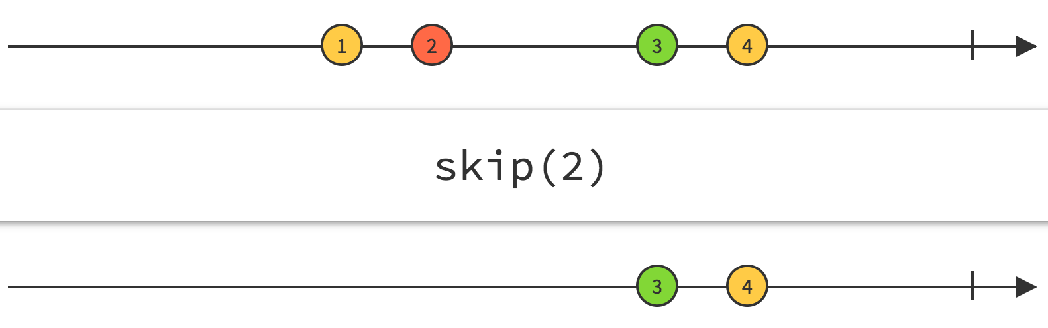
skip

Slide 31
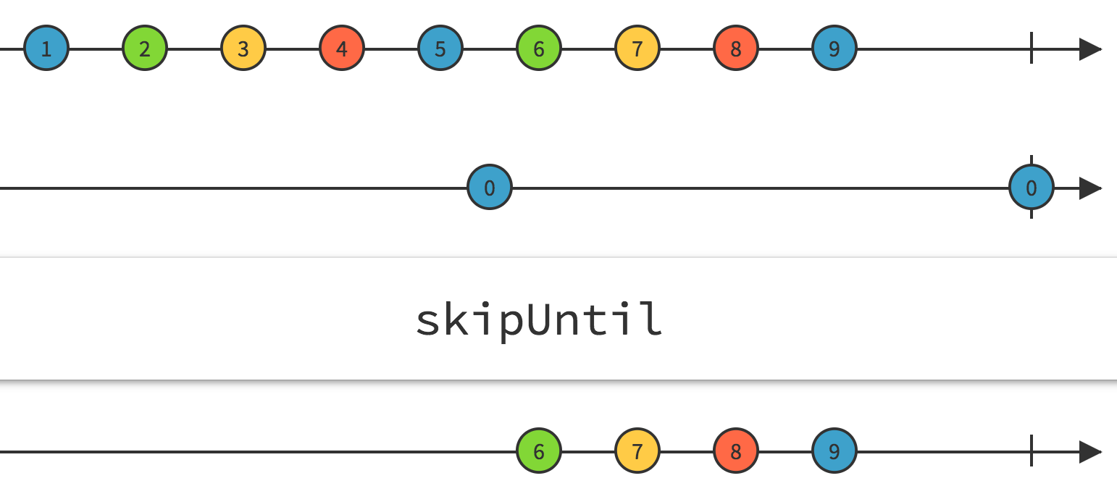
skipuntil
skipUntil(x=>x<6)

Slide 32
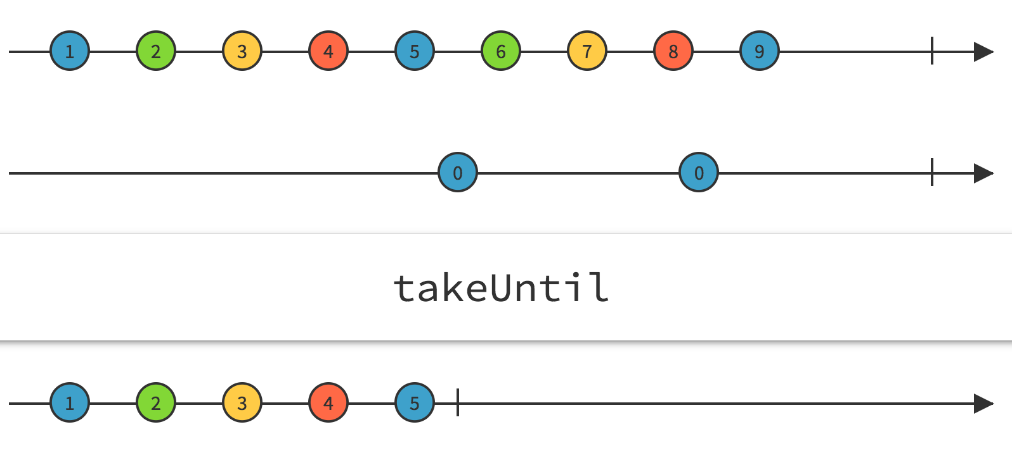
takeuntil
takeUntil(x=>x>5)

Slide 33
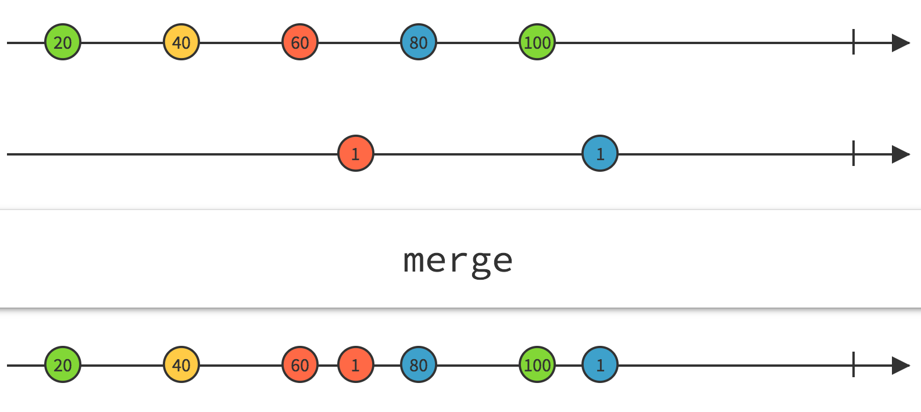
Merge operator

Slide 34
Operator summary
Simple operators
• map() • filter() • reduce() • first() • last() • single() • elementAt()
• toArray() • isEmpty() • take() • skip() • startWith()
• many more…
Merging and joining operators
• merge • mergeMap (flatMap) • concat • concatMap • switch
• switchMap • combineLatest • withLatestFrom • zip • forkJoin • expand
Splitting and grouping operators
• groupBy • window • partition
Buffering strategy operators
• buffer • throttle • debounce • sample

Slide 35
How angular 2 use observables?
Angular 2 currently uses RxJs Observables in two different ways:
as an internal implementation mechanism, to implement some of its core logic like EventEmitter
as part of its public API, namely in Forms and the HTTP module

Slide 36
Processing input box changes with rxjs
@Component({ selector: 'my-app', template: `<input [formControl]="searchBox" /> {{searchResults}} ` }) export class App { searchBox: FormControl = new FormControl(); searchResults: string; constructor(httpService: HttpService) { this.searchBox.valueChanges .debounceTime(500) .distinctUntilChanged() .switchMap(data => this.httpService.getListValues(data)) .subscribe(res=>this.searchResults=res, (err: Error) => console.log(err)); } }

Slide 37
Processing async data with rxjs
/* Get stock data somehow */ const source = getAsyncStockData(); const subscription = source .filter(quote => quote.price > 30) .map(quote => quote.price) .forEach(price => console.log(`Prices higher than $30: ${price}`);

Slide 38
Processing async data with rxjs
// Listen to keypresses on input Observable.fromEvent(searchInput, 'keyup') // Get the value of the input .map(event => event.target.value) // Only pass through values with 3 or more characters .filter(value => value.length > 2) // As keypresses does not necessarily change the value of the input // make sure we only move on when the value has changed .distinctUntilChanged() // Only move on with latest keypress with 500 ms interval .debounceTime(500) // Send search request, retry 3 times on fail and return request. Since we // return a request observable we need to use flatMap to extract the actual value .flatMap(value => this.http.get(`/api/items?query=${value}`).retry(3)) // Extract the data of the response .map(response => response.data) // Render the items .forEach(items => renderItems(items)) // If something fails show error .catch(err => renderError(err.message))

Slide 39


